Slide 1
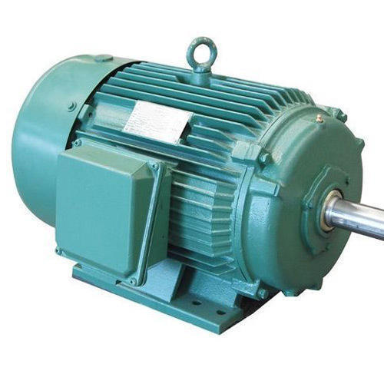
Induction Motor

Slide 2
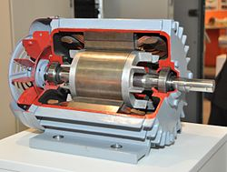
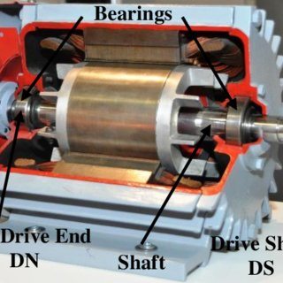

Slide 3
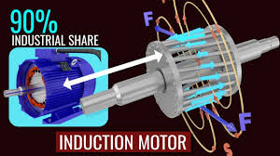

Slide 4
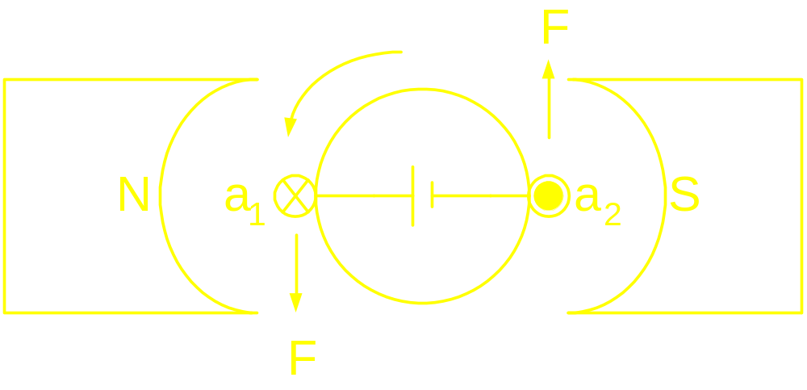
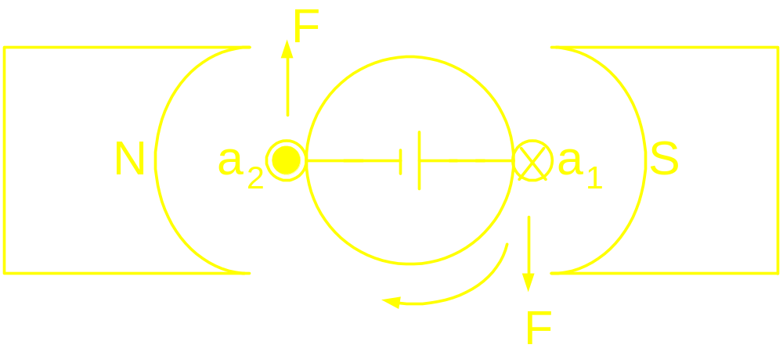
Induction Machine: Concept

Slide 5
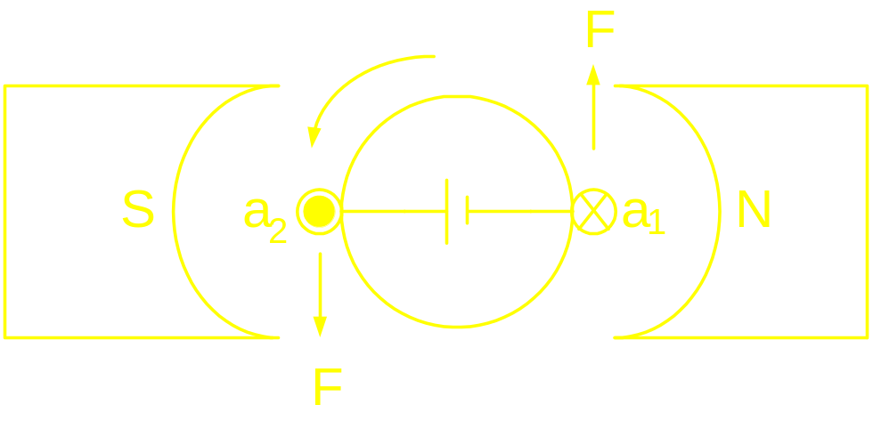

Induction Machine: Concept
Stator field has been
Rotated by 180⁰

Slide 6
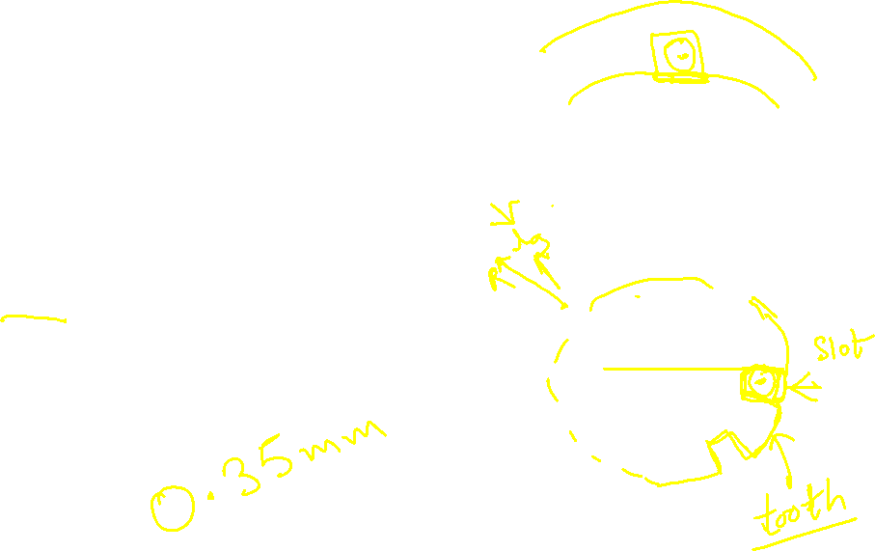

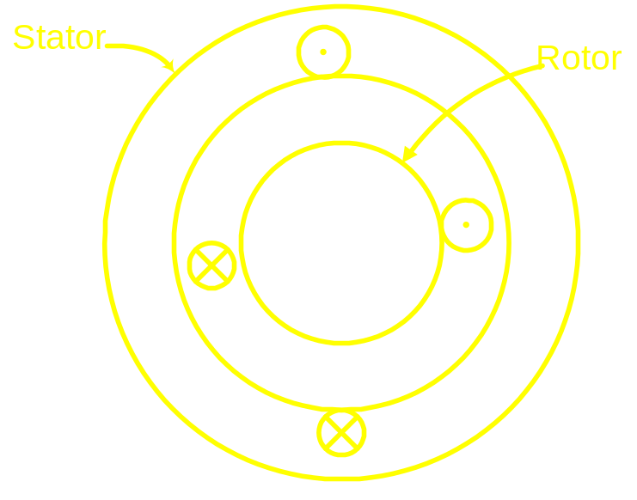
Elementary Induction Motor
Assumptions:
a
Magnetic circuit is linear
Permeability of the iron
path is infinite
slot effects are neglected
airgap length is much smaller
compared to the mean radius
of the airgap
a/

Slide 7
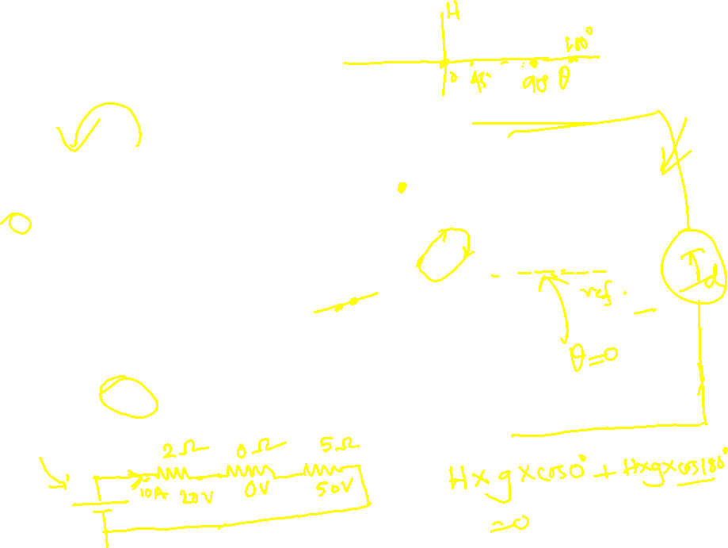
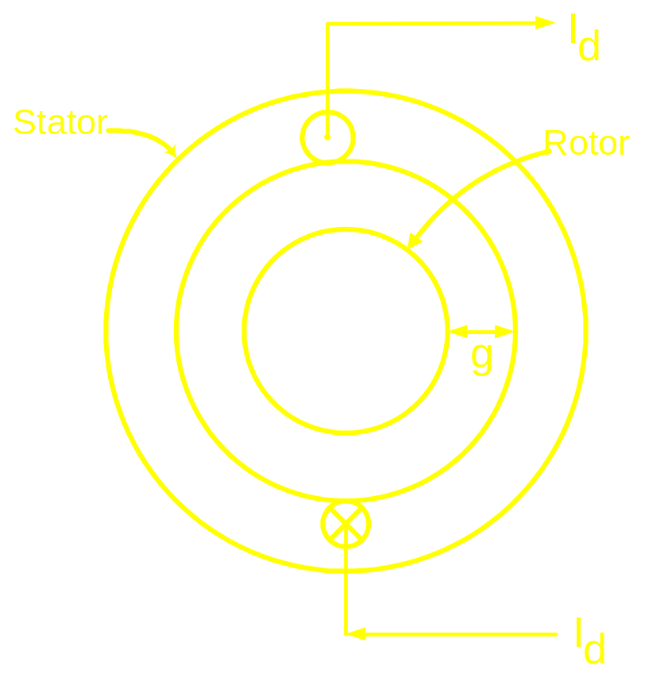


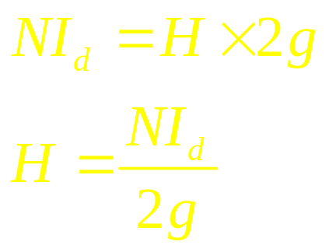
Ampere’s Law
a
For this case:
a/

Slide 8
